Slide 1
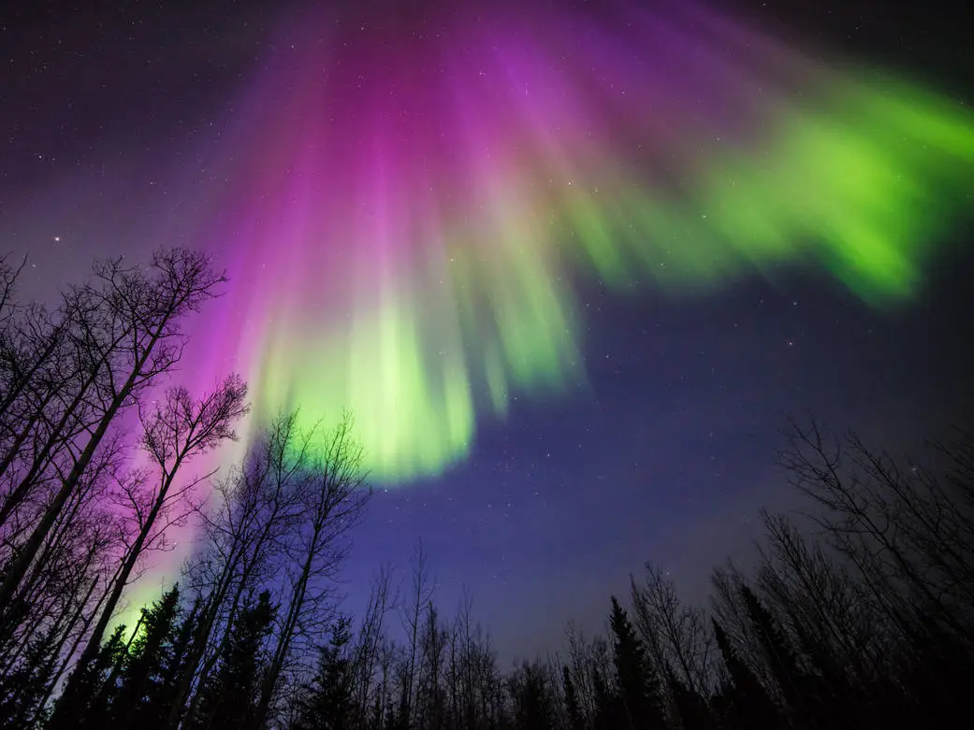



Analyzing Aurora Observed by Instruments at Poker Flat, Alaska to Better Understand Geomagnetic Activity
Harshita Prasad
Faculty Mentor: Dr. Katrina Bossert (School of Earth and Space Exploration)
Graduate Student Mentor: Tyler Karasinski (School of Earth and Space Exploration)
Arizona NASA Space Grant Statewide Student Research Symposium
SkySong ASU Scottsdale Innovation Center
April 18, 2026
Photo credit: https://www.nasa.gov/image-article/purple-green-aurora-alaska/ (Image Courtesy of Sebastian Saarloos)

Slide 2


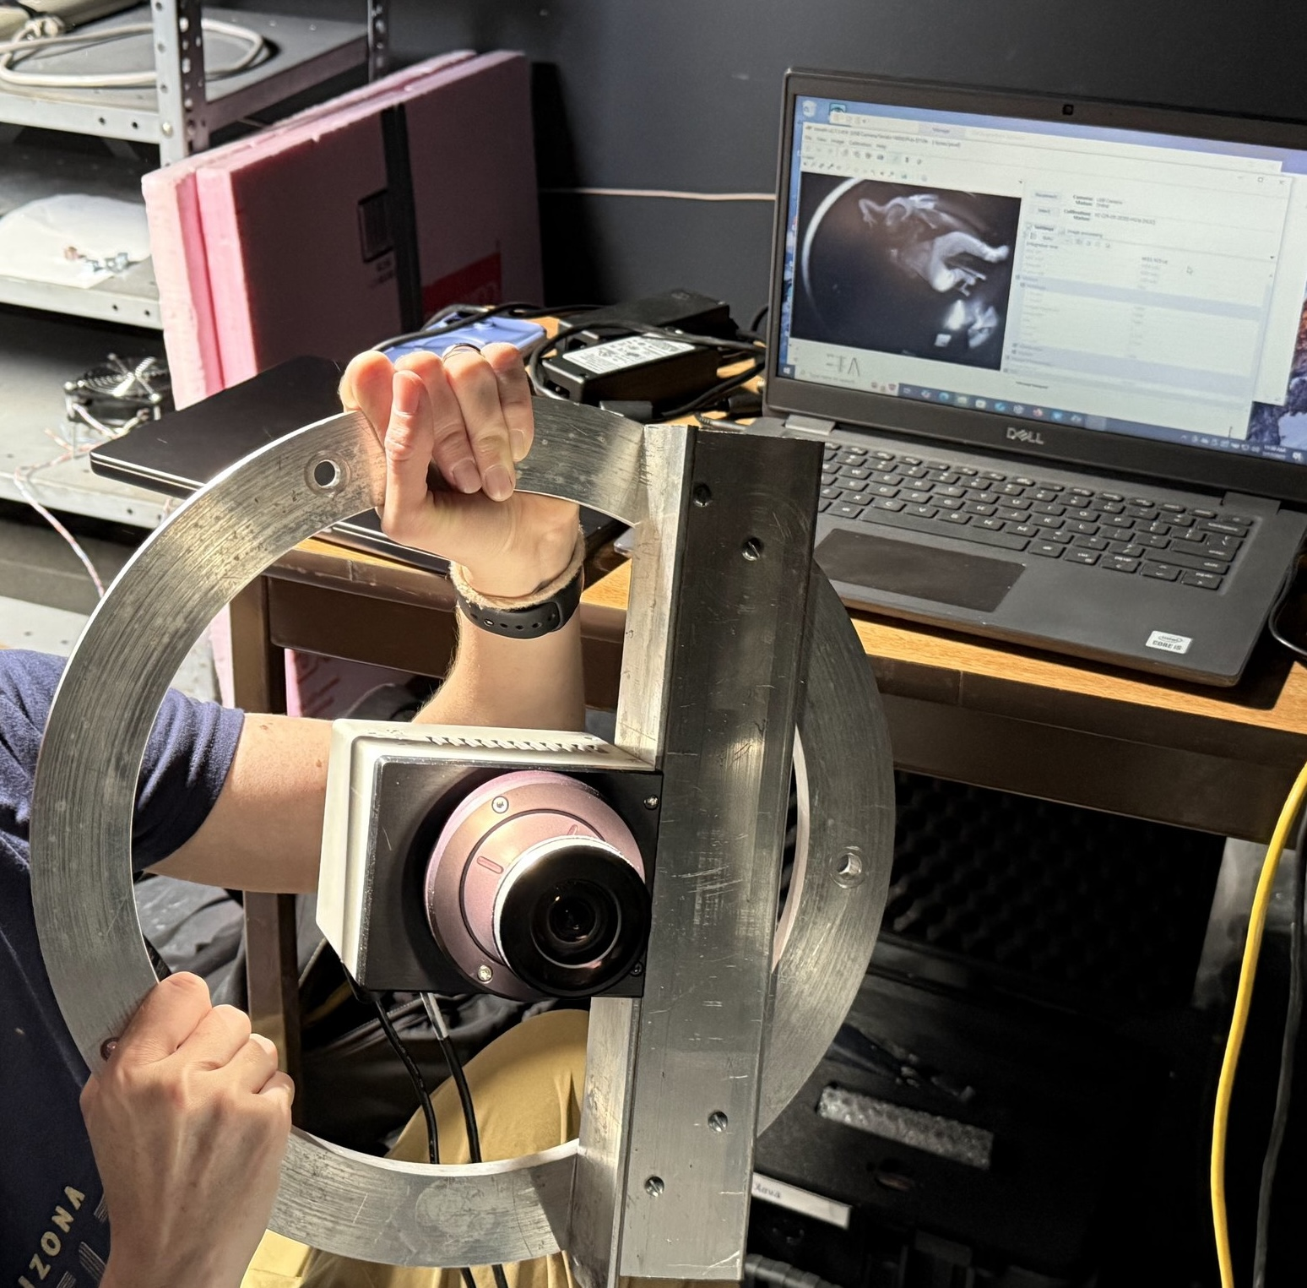
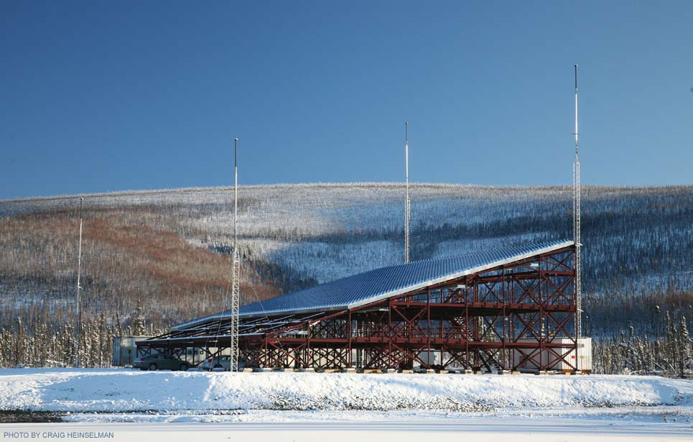
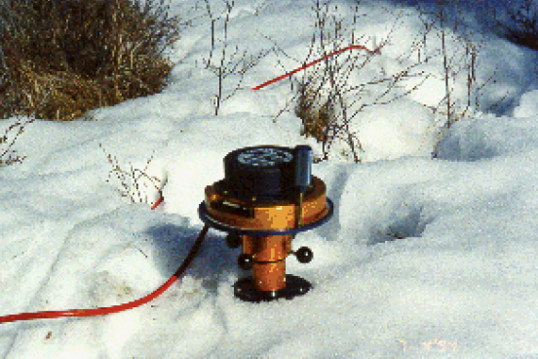
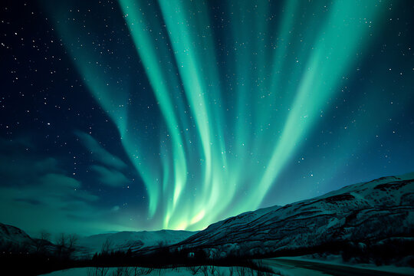
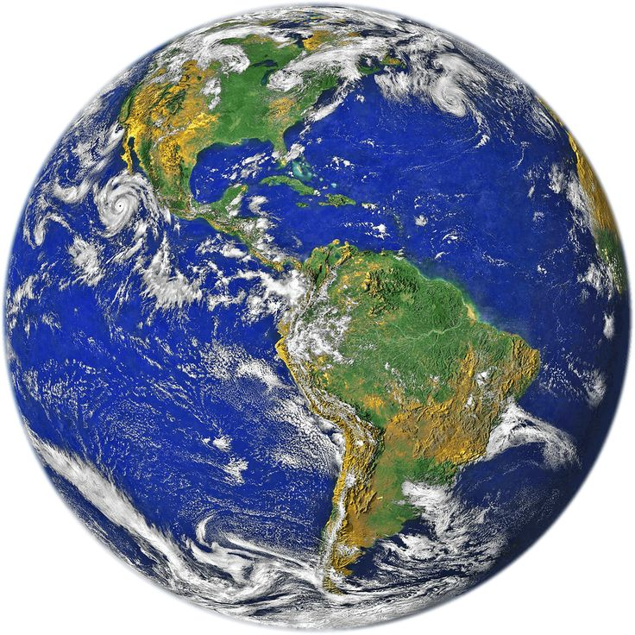
Geomagnetic storm
Background: Space Physics
After build up of charged particles in the Earth’s magnetotail, the particles precipitate into Earth’s atmosphere. This is aurora.
Infrared imager photo thanks to: Tyler Karasinski
Magnetometer photo source: Elizabeth Kendall, SRI International; Don Hampton, University of Alaska Fairbanks
AMISR photo credit: https://www.pfrr.alaska.edu/facilities/
Aurora clip art: Adobe stock
Earth clip art: creazilla.com
Solar wind
Charged particles travel along the magnetic field lines in the Earth’s magnetosphere.
Ground-based magnetometer captures fluctuations in the magnetic field
Poker Flat Incoherent Scatter Radar (PFISR) detects electron enhancements in the charged atmosphere
Aurora is seen through the Poker Flat infrared imager, which detects wavelengths between ~900-1700nm

Slide 3
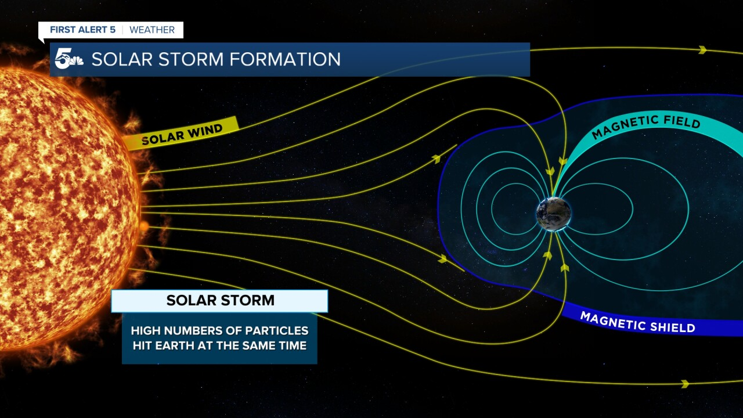
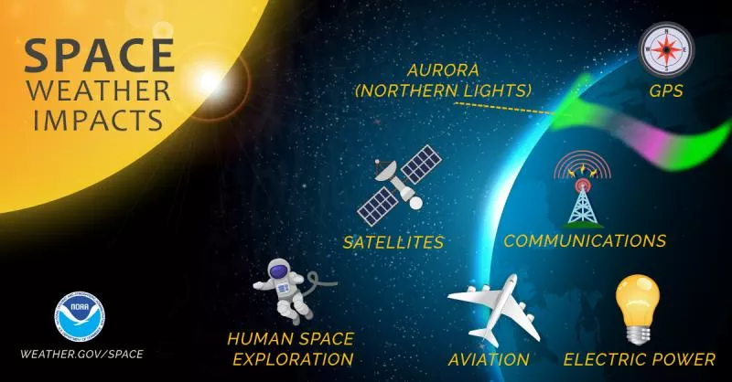
Introducing the Mysteries of Aurora
Relevance to daily human life
Aurora occurrences are associated with (1) geomagnetic activity and (2) high electron enhancement, but instruments reveal this is not always what happens.
How many times in one observing season do three instruments display inconsistent information about natural phenomena?
Research Objectives: To characterize and quantify specific discrepancies between aurora occurrences, magnetic field fluctuations, and spikes in electron density.
Solar storm graphic source: https://www.koaa.com/weather/weather-science/powerful-solar-storm-may-produce-northern-lights-disrupt-power-in-colorado
Space weather graphic source: https://www.nesdis.noaa.gov/news/noaa-moves-one-step-closer-its-next-space-weather-satellite-mission

Slide 4
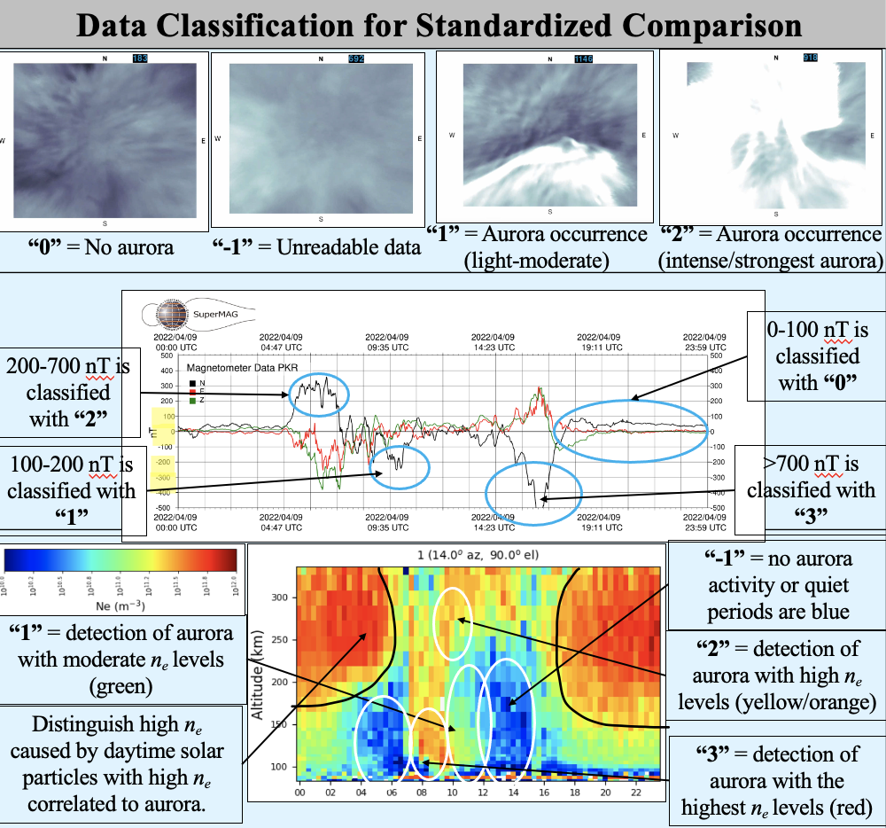
Methods and Analysis
Infrared Imager
Analyze infrared imager data to document aurora.¹
Magnetometer
Read magnetometer plots from public database (magnetic north orientation).
Incoherent Scatter Radar
Categorize ISR plot data using the classification scheme to document electron density (n_{e}).
Instruments to detect aurora
or its signatures
2021-2022 observing season at Poker Flat, Alaska

Slide 5
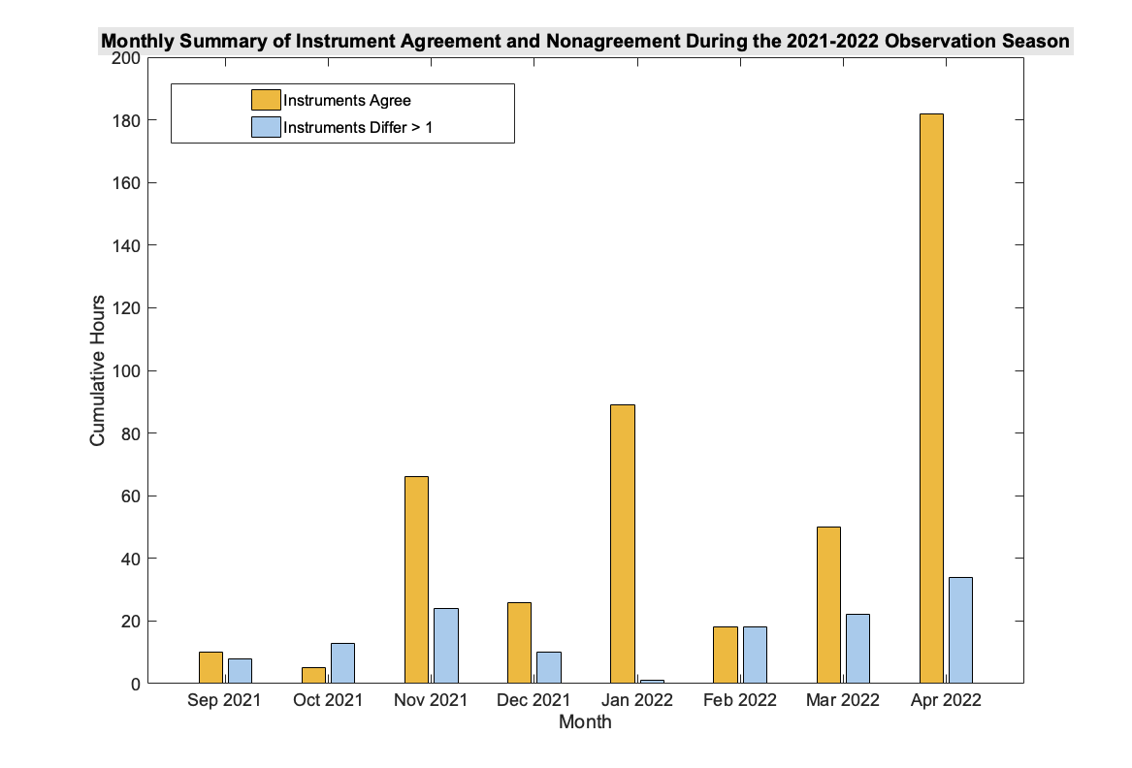
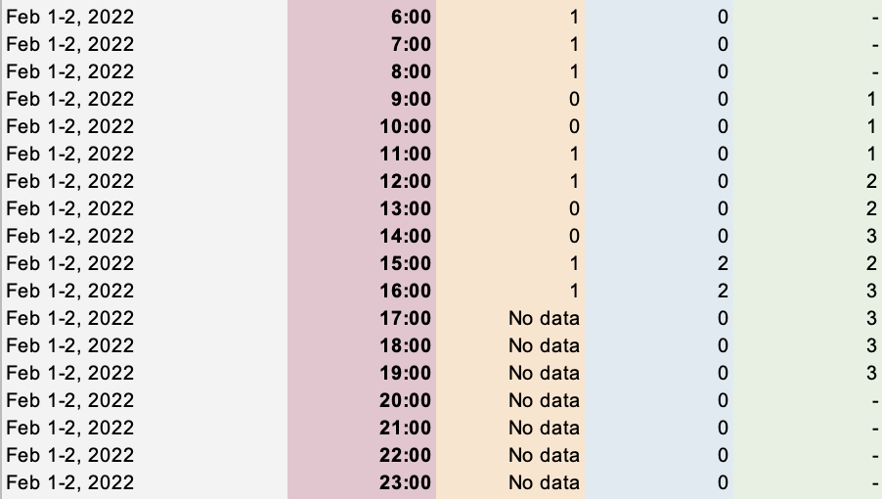
Results from 2021-2022 Observing Season
Imager
Magnetometer
ISR
TIME
Figure 1. Data sheet displaying one night from the season of interest.
Figure 2. Instruments do not agree with each other for a significant number of hours each month of this season.

Slide 6
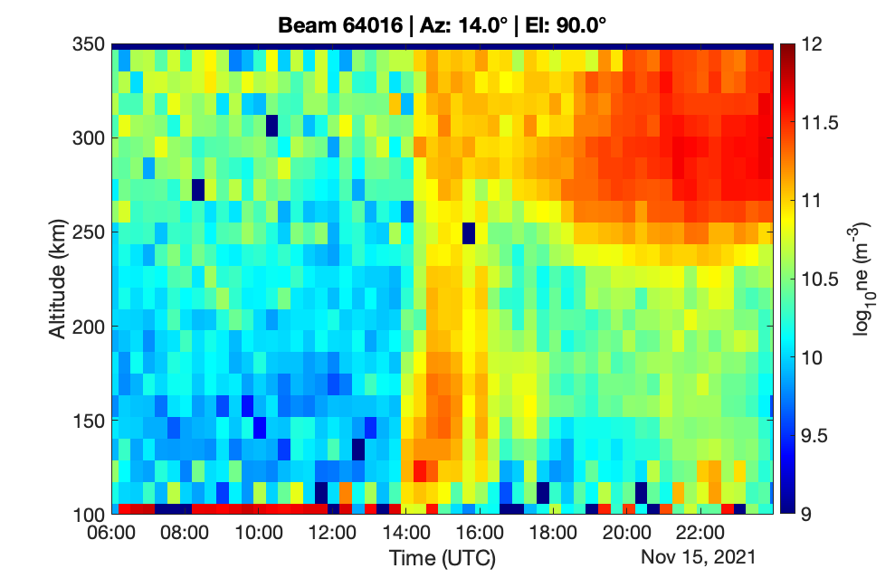
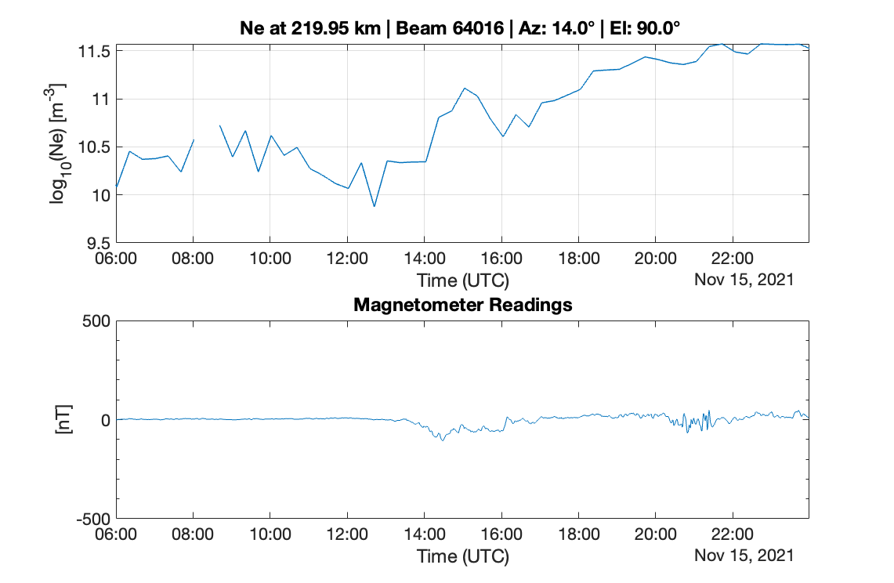

Case Study: November 15, 2021
Photoionization due to daytime (not aurora)
Sunrise

Slide 7
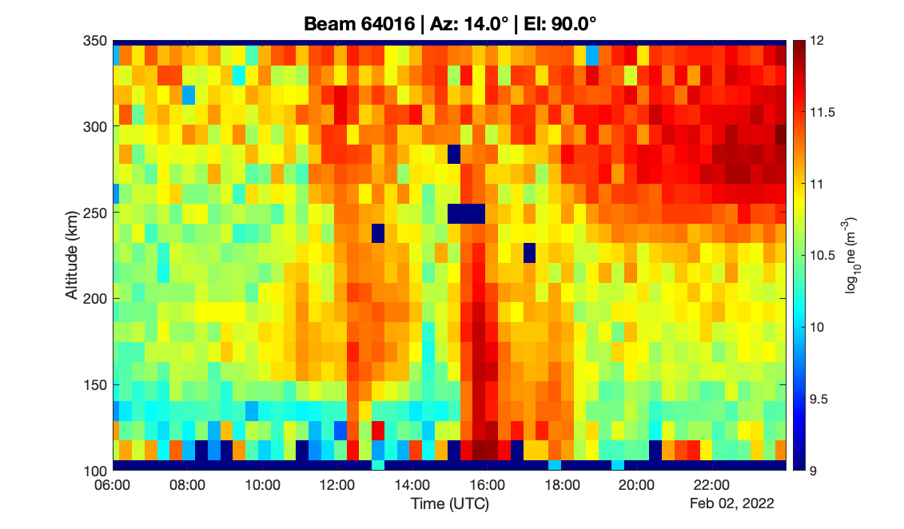
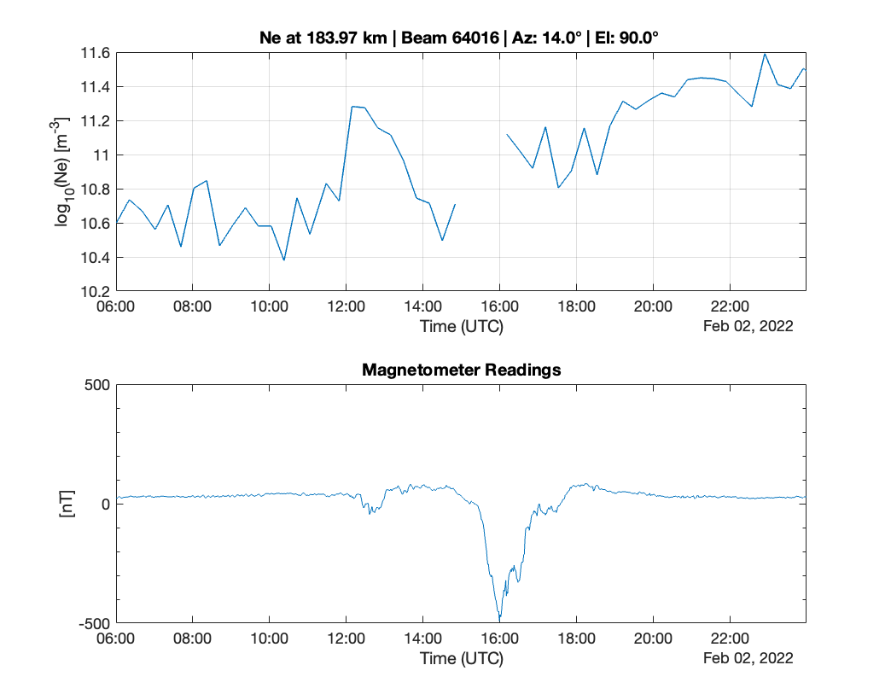


Case Study: February 2, 2022
Photoionization
Photoionization
Sunrise
Only ISR signatures of aurora during night hours are considered (ignore photoionization during daytime).
2 periods of instrument agreement, 1 period of disagreement.

Slide 8
Conclusions + Future Work
Each aurora occurrence does not coincide with expected uptick in magnetometer activity and/or spike in electron density.
Research deepens understanding of aurora and how it may/may not show up on different instruments through the variables of magnetic field activity and high electron density.
Next steps:
Identify disagreements between instruments for more winter seasons.
Utilize Citizen Science volunteer responses for imager video analysis.
Of the 216 total hours documented for April 2022:
182 hours of data showed all instruments in agreement.
34 hours of the month (15.7% of monthly hours) indicate instrument disagreement.
Month | Agree Counts | Not Agree Counts
Apr 2022 | 182 | 34
Month of the 2021-2022 Season | Quantify disagreements
September 2021 | 44.4% of monthly hours
October 2021 | 72.2% of monthly hours
November 2021 | 26.7% of monthly hours
December 2021 | 27.8% of monthly hours
January 2022 | 1.1% of monthly hours
February 2022 | 50% of monthly hours
March 2022 | 30.6% of monthly hours
April 2022 | 15.7% of monthly hours

Slide 9
References
Acknowledgements
Karasinski, T. M., Bossert, K., Berkheimer, J., Norrell, J. M., Phillips, S. R., Muñoz, K., & Pautet, P. D. (2025). Gravity wave zoo: engaging citizen science to analyze atmospheric gravity wave activity over Poker Flat, Alaska. Frontiers in Astronomy and Space Sciences, 12, 1657864.
ISR Data PI: Asti Bhatt. Rideout W., Cariglia K. CEDAR Madrigal Database URL: https://cedar.openmadrigal.org
SuperMAG Database. https://supermag.jhuapl.edu/
Dr. Katrina Bossert, Tyler Karasinski
Bossert Research Group
Desiree Crawl, Dr. Tom Sharp
Arizona/NASA Space Grant Consortium Staff
School of Earth and Space Exploration
NASA Office of STEM Engagement
The material contained in this document is based upon work supported by a National Aeronautics and Space Administration (NASA) cooperative agreement 80NSSC20M0041 or 80NSSC25M7084* (see note below). Any opinions, findings, conclusions or recommendations expressed in this material are those of the author and do not necessarily reflect the views of NASA. This work was supported through a NASA grant awarded to the Arizona/NASA Space Grant Consortium.
*Note: 80NSSC20M0041 is for funding between FY20-25. 80NSSC25M7084 is for funding between FY25-29.

Slide 10
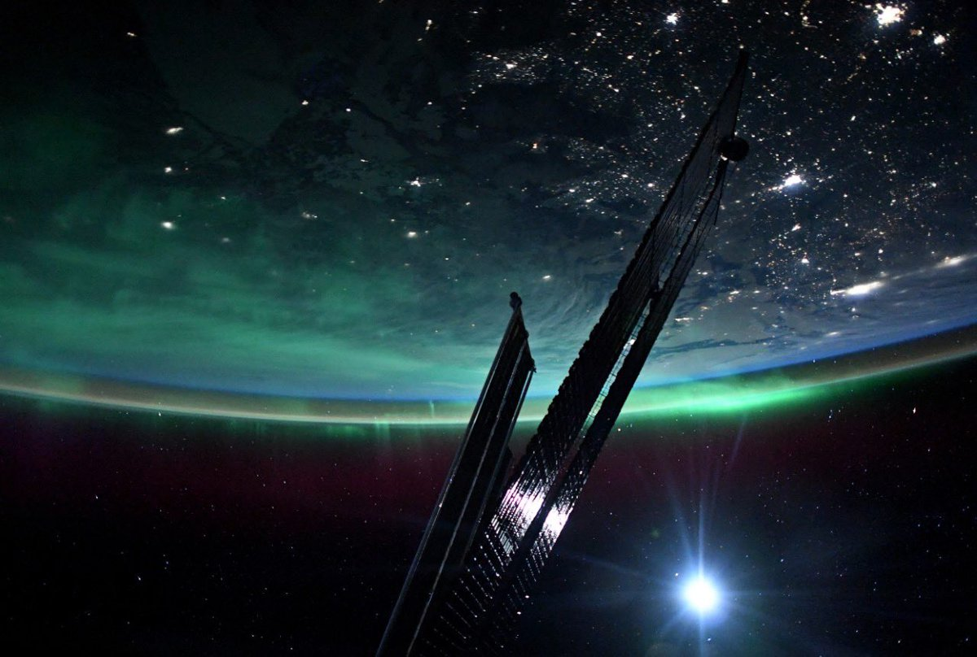
Thank you to the audience for your time today.
For any questions and comments:
hprasad1@asu.edu
Image source: NASA/Josh Cassada

